Slide 1

PROJECT PRESENTATION
ON
EMPLOYEE ATTRITION
Submitted By:
Sherin Joseph
27-Nov-2021

Slide 2
Outline
Introduction
Background
Objectives of Analysis
Methodology
Study Variables
Univariate and Bivariate Analysis
Feature Engineering
Modelling
Hypothesis Testing and Findings
Conclusions and Recommendations

Slide 3
introduction
The project deals with the employee attrition in a company.
The company uses the observational data to analyse and interpret where highest attrition occurs.
They would like to know which category of employees are more subjected to attrition.
The meaningful insights derived from the data would enable the company to take necessary actions to deal with employees in a much efficient manner and reduce attrition rate in future.

Slide 4
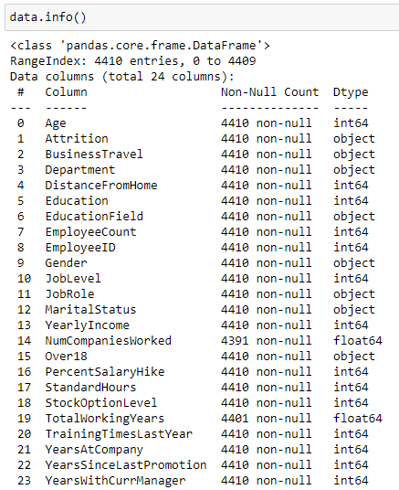
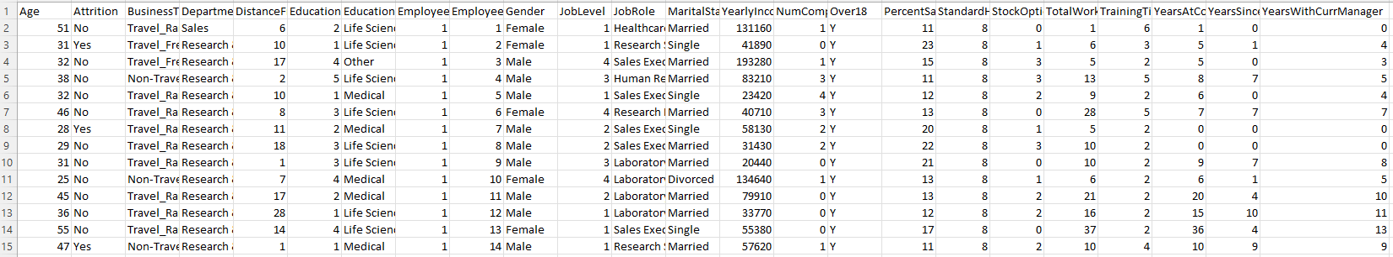
Background
The dataset consists of the employee data from a company.
There are 4410 observations and 24 columns

Slide 5
Objectives
Is the attrition significantly different across different age groups.
Which department has seen its employees leaving the job more compared to others.
Is the distance travelled by the employee a reason for them to leave the company.
Does the attrition depend on field of education of employees. If yes, employees from which field have left their jobs more than others.
Are the employees with lower wages more subjected to attrition than those with high income.
If the employees with higher tenure years in the company have less attrition compared to the new staffs in the company.
If the employees who have not recently been promoted have higher attrition compared to those who have been promoted recently.

Slide 6
Methodology
Inclusions
The dataset do not have any duplicate values and hence all observations are included for analysis.
Exclusions
The variables such as ‘EmployeeCount’, ‘Over18’ and ‘StandardHours’ are having same values for all observations and hence they are excluded from analysis.
There are some missing values in ‘TotalWorkingYears’ which are replaced with the value in corresponding 'YearsAtCompany' field instead of 0 as though this company is the employees first company.
There are some missing values in ‘NumCompaniesWorked’ which are replaced with the mode values corresponding to the 'JobLevel' and 'Education' of the respective columns.
Software
Python using Jupyter Notebook.
Statistical Methods
Logistic Regression, KNN, Addaboost, SVM and Random Forest

Slide 7
Study variables
Independent Variables
Dependent Variables
1
Age
2
BusinessTravel
3
5
6
7
8
9
10
11
12
13
14
15
16
17
18
19
Department
Education
EducationField
JobLevel
MaritalStatus
NumCompaniesWorked
PercentSalaryHike
StockOptionLevel
TotalWorkingYears
TrainingTimesLastYear
YearsAtCompany
YearsSinceLastPromotion
YearsWithCurrManager
4
YearlyIncome
DistanceFromHome
JobRole
Gender
Attrition

Slide 8
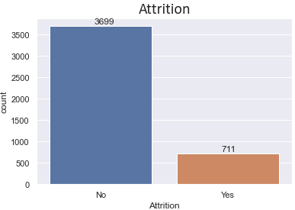
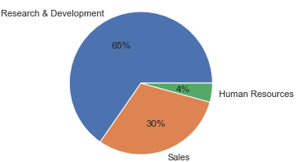
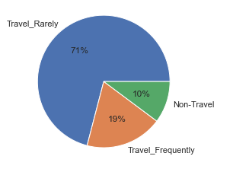
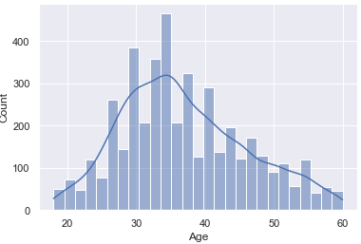
Univariate analysis
The distribution of attrition shows that most employees stayed with company. Only 711 people have left the company.
The group of employees who have rarely traveled for business requirements are more compared to other groups.
The Research and Development department is the biggest one with 65% of employees.
The histogram shows the age distribution and the average age of employees is around 35 years.
Department
Business Travel

Slide 9
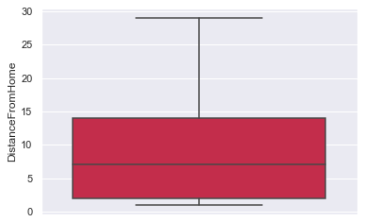
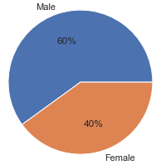
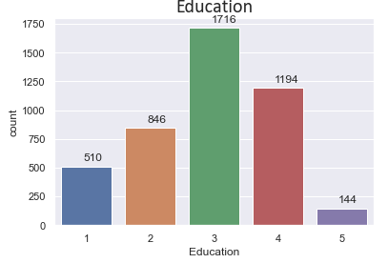
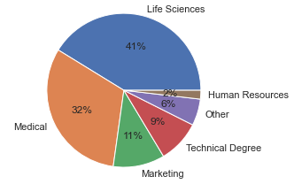
Gender
Most of employees travel from 3-14 kms from their home to the company.
Exactly 60% of the employees are Males and 40% are Females.
Most of the employees had their education in the field of Life Science and Medical field. Least were from HR background (2%).
Highest percent of employees had education level of 3 and least group were in level 5.
Education Field

Slide 10
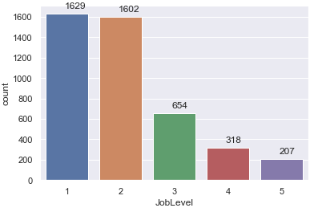
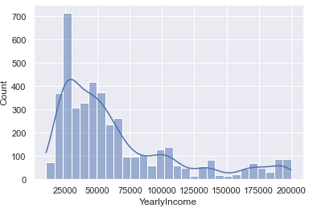
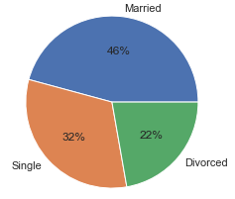
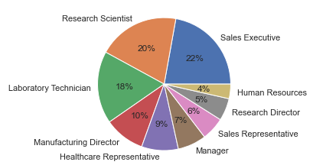
It is seen that as the job level increases from 1 to 5 (junior to manager), the count of employees tend to reduce.
Most of the employees had an annual salary between 25000 and 75000.
About 46% of employees were marries and 32% were single. 22% of them were divorced.
The Sales Executives made 20% of the employees and the least was HR team with only 4% of total employees.
Marital Status
Job Role

Slide 11
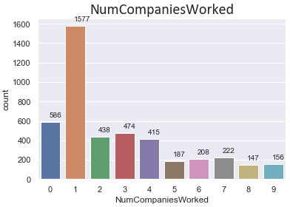
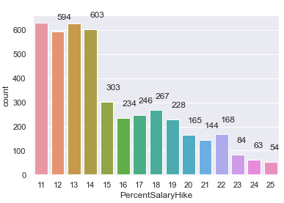
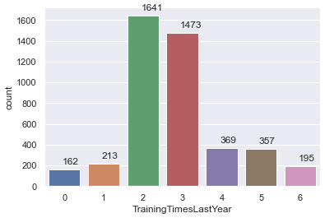
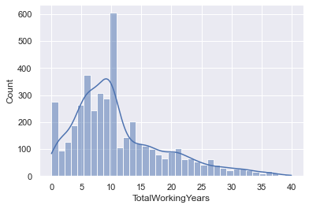
The people who have worked in 1 company is top of the list. The count of it is 1577.
Most of the employees had a hike less than 15%. Only 54 employees had hike of 25% in their salary.
There were 1641 employees who took the training 2 time last years and that group was top in the list.
Majority of employees had total working years of less than 10 years.

Slide 12
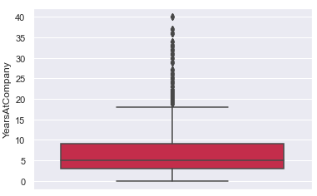
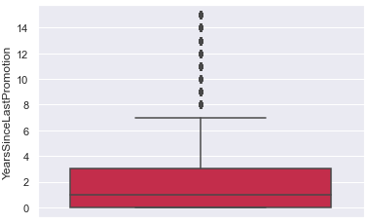
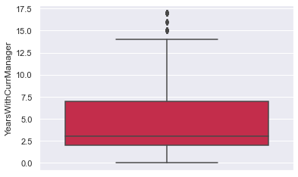
Most employees in the company was between 4 to 9 years within the company. A few of them were over 20 years.
Most of them were recently promoted within last 3 years. A few employees were not promoted for more than 8 years.
For most employees, they stayed with same manager for 2-7 years within the company.

Slide 13
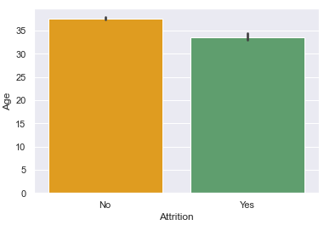
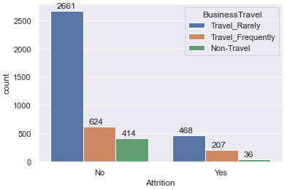
Bivariate analysis
The mean age of employees who left the company was slightly lower than the employees who stayed with in the company. It means the younger employees leave company more than the seniors.
The attrition in the employees who rarely travelled for business purpose was almost double the rate as compared to those who frequently had business travel.

Slide 14
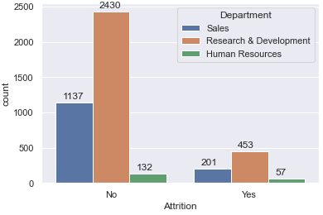
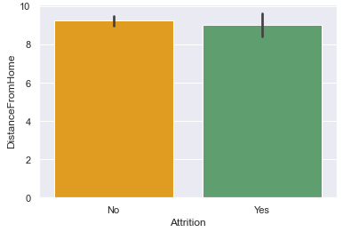
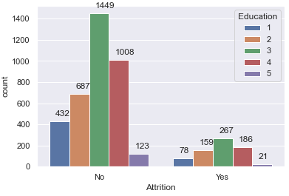
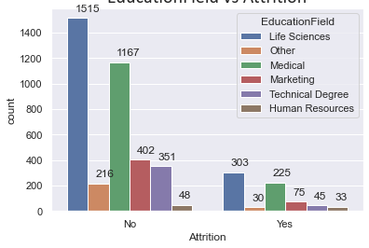
We could see that the employees in Research and Development department were prone to attrition than other departments.
The average distance travelled to company from home by employees who left the company and who stayed in company are almost the same.
The employees who left the company had medium level of education.
The people in field of Life Science and Medical field were more subjected to attrition than others.

Slide 15
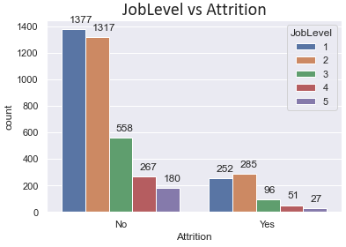
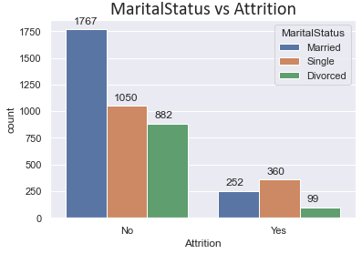
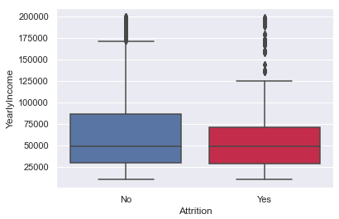
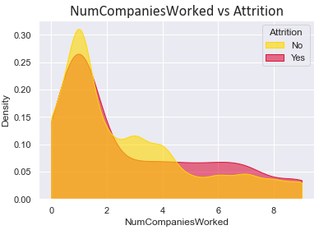
It is seen that as the job level increases, the attrition rate decreases.
Its seen that the employees who were single left the company more compared to others.
Yearly income is not a significant feature to explain the attrition as the mean values of either categories are almost same.
The density plot shows the attritions across the number of companies worked. As the number of companies worked increase, the attrition level reduces.

Slide 16
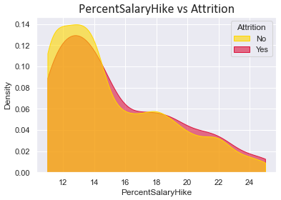
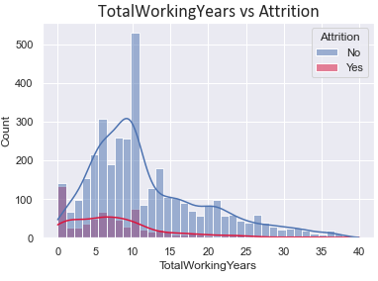
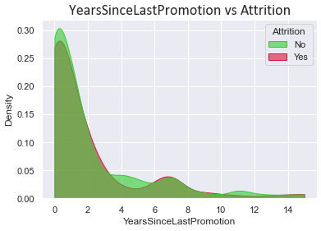
The density plot shows that when the precent of salary hike is high, then employees chance of leaving the company is less.
The employees leaves the company mainly in their initial stages of their career. Once their gain more experience, they tend to stick on to the company.
The people who got promoted recently tend to leave company more than those got it a long ago.

Slide 17
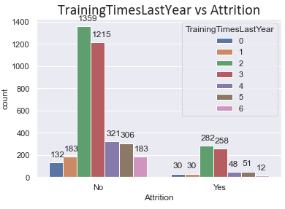
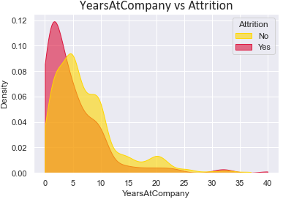
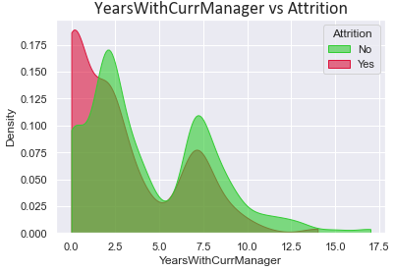
The employees who took training 2 or 3 times left the company more compared to employees who took more or less training times.
It is seen that as the experience in the company increase, there are less chances they leave the company.
When the employees work under same manager for long, the attrition rate reduces.

Slide 18

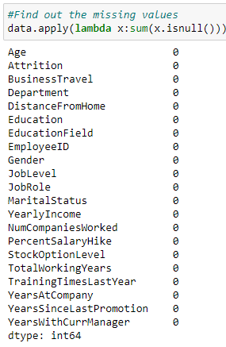
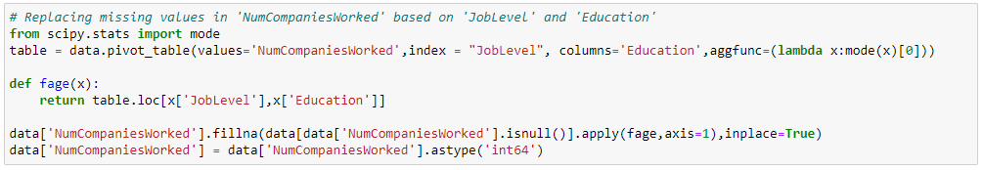
Handling missing values
There are no duplicate observations in the dataset.
There were some missing values in the 'TotalWorkingYears'. They are replaced with the value in corresponding 'YearsAtCompany' field instead of 0 as though this company is the employees first company.
The missing values in the 'NumCompaniesWorked' is replaced with the mode values corresponding to the 'JobLevel' and 'Education' of the respective columns.

Slide 19
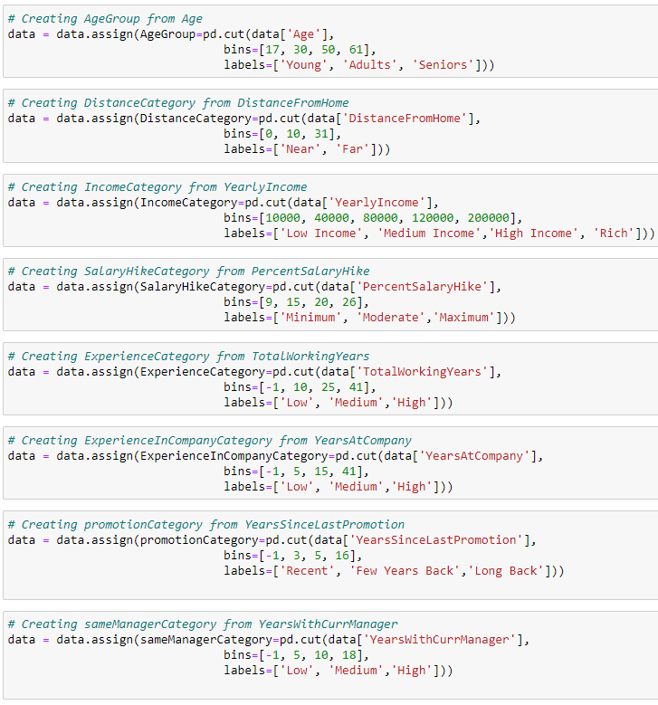
Feature engineering
Age => Age Group
DistanceFromHome => Distance Category
YearlyIncome => Income Category
PercentSalaryHike => Salary Hike Category
TotalWorkingYears => Experience Category
YearsAtCompany => ExperienceInCompanyCategory
YearsSinceLastPromotion => Promotion Time category
YearsWithCurrManager => CurrentManager Category

Slide 20
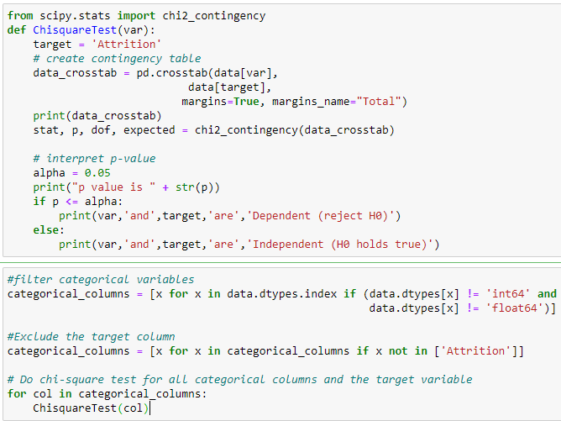
Chi-square Summary
Variable | P-Value | Relevant
BusinessTravel | 1.2264572393247815e-13 | Yes
Department | 5.84897393561658e-05 | Yes
EducationField | 6.421844581631005e-06 | Yes
Gender | 0.8356764160313717 | No
JobRole | 0.12174569127114664 | No
MaritalStatus | 2.0861725602157853e-27 | Yes
AgeGroup | 1.1602583974931013e-21 | Yes
DistanceCategory | 0.9962038617379816 | No
IncomeCategory | 0.49107048938622566 | No
SalaryHikeCategory | 0.8126508812674836 | No
ExperienceCategory | 9.937931359997116e-14 | Yes
promotionCategory | 0.0007464007759094239 | Yes
sameManagerCategory | 5.785819377061715e-10 | Yes

Slide 21
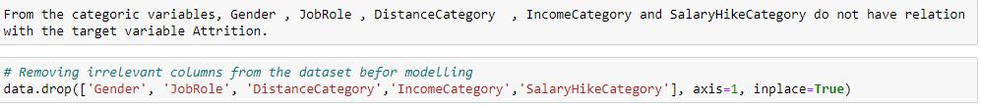
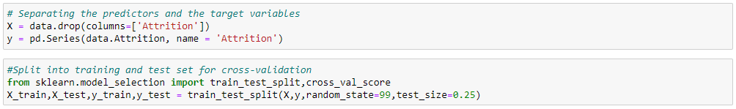
Preparation for modelling

Slide 22





Model comparison
Model | K-Fold Value | Accuracy | Confusion Matrix
Logistic Regression | 0.846 | 0.85
KNN | 0.877 | 0.86
Random Forest | 0.997 | 0.99
Adaboost | 0.845 | 0.85
SVM | 0.838 | 0.85

Slide 23
conclusions
The level of attrition is significantly different across different age groups. Young employees leave company more than seniors.
The Research and Development department had seen most attrition of its employees compared to other departments.
The people in field of Life Science and Medical field were more subjected to attrition than others.
The distance travelled by the employees to reach office does not play significant role in attrition.
The attrition rate does not depend on the annual income of the employees.
It is seen that the employees with high tenure years in company have less attrition compared to new staffs.
The people who got promoted recently tend to leave company more than those who got it a long ago.
The attrition in the employees who rarely travelled for business purpose was almost double the rate as compared to those who frequently had business travel.
As the job level increases from junior to manager level, the attrition rate decreases.
Employees who were single, left the company more compared to married and divorced employees.

Slide 24

RECOMMENDATIONS
The employees in the Research and Development department especially from Life Science and Medical field should be given more attention so that they do not leave the company very soon.
Company could provide the employees more benefits in terms of insurance, pension plans or company shares if they stay with company for more than 10 years. Thus the chance of attrition can be reduced.
If legal, company could make some agreements with employees when they get promoted that they would successfully carry out the new roles for a certain time period.

Slide 25

Thank you

